Slide 1
Multithreading

Slide 2
Multitasking
More than one activity in memory and processor can switch among all to execute them
Co-operative multitasking
Preemptive multitasking

Slide 3
Multithreading
Process – A program in execution
Threads- A process is divided into multiple independent units.
Threads are light weight processes
Multitasking can be
Process based
Thread based

Slide 4
Advantages of Threads
Share the same address space
Context switching between threads is inexpensive
Inter thread Communication is inexpensive.

Slide 5
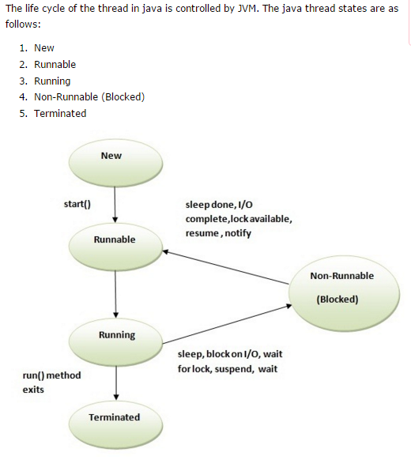
Thread Lifecyle

Slide 6
1) New
The thread is in new state if you create an instance of Thread class but before the invocation of start() method.
2) Runnable
The thread is in runnable state after invocation of start() method, but the thread scheduler has not selected it to be the running thread.
3) Running
The thread is in running state if the thread scheduler has selected it.
4) Non-Runnable (Blocked)
This is the state when the thread is still alive, but is currently not eligible to run.
5) Terminated
A thread is in terminated or dead state when its run() method exits.

Slide 7
Thread Creation in JAVA
Create a class that extends the standard Thread class
Create a class that implements the standard Runnable interface.

Slide 8
Extending Thread Class
Class MyThread extends Thread
{
public void run(){
//thread body of execution
}
}
Create Thread object
MyThread mt = new MyThread();
Start Execution
mt.start();

Slide 9
Implementing Runnable Interface
Class MyThread implements Runnable
{
public void run(){
//thread body of execution
}
}
Create object
MyThread mt = new MyThread();
Create Thread Object
Thread th = new Thread(mt);
Start Execution
th.start();

Slide 10
Methods in Thread class
The Thread class defines several methods that help manage threads.
Method Meaning
getName Obtain a thread’s name.
getPriority Obtain a thread’s priority.
isAlive Determine if a thread is still running.
join Wait for a thread to terminate.
run Entry point for the thread.
sleep Suspend a thread for a period of time.
start Start a thread by calling its run method.

Slide 11
Controlling Main Thread
// Controlling the main Thread.
class CurrentThreadDemo {
public static void main(String args[]) {
Thread t = Thread.currentThread();
System.out.println("Current thread: " + t);
// change the name of the thread
t.setName("My Thread");
System.out.println("After name change: " + t);
try {
for(int n = 5; n > 0; n--) {
System.out.println(n);
Thread.sleep(1000);
}
} catch (InterruptedException e) {
System.out.println("Main thread interrupted");
}
}
}
Current thread: Thread[main,5,main]
After name change: Thread[My Thread,5,main]
5
4
3
2
1

Slide 12
Prototypes of Methods
static void sleep(long milliseconds) throws InterruptedException
final void setName(String threadName)
final String getName( )

Slide 13
Runnable Interface Demo
// Create a second thread.
class NewThread implements Runnable {
Thread t;
NewThread() {
// Create a new, second thread
t = new Thread(this, "Demo Thread");
System.out.println("Child thread: " + t);
t.start(); // Start the thread
}
// This is the entry point for the second thread.
public void run() {
try {
for(int i = 5; i > 0; i--) {
System.out.println("Child Thread: " + i);
Thread.sleep(500);
}
} catch (InterruptedException e) {
System.out.println("Child interrupted.");
}
System.out.println("Exiting child thread.");
}
}

Slide 14
class ThreadDemo {
public static void main(String args[]) {
new NewThread(); // create a new thread
try {
for(int i = 5; i > 0; i--) {
System.out.println("Main Thread: " + i);
Thread.sleep(1000);
}
} catch (InterruptedException e) {
System.out.println("Main thread interrupted.");
}
System.out.println("Main thread exiting.");
}
}
Child thread: Thread[Demo Thread,5,main]
Main Thread: 5
Child Thread: 5
Child Thread: 4
Main Thread: 4
Child Thread: 3
Child Thread: 2
Main Thread: 3
Child Thread: 1
Exiting child thread.
Main Thread: 2
Main Thread: 1
Main thread exiting.

Slide 15
Multiple Threads
/ /Create multiple threads.
class NewThread implements Runnable {
String name; // name of thread
Thread t;
NewThread(String threadname) {
name = threadname;
t = new Thread(this, name);
System.out.println("New thread: " + t);
t.start(); // Start the thread
}
// This is the entry point for thread.
public void run() {
try {
for(int i = 5; i > 0; i--) {
System.out.println(name + ": " + i);
Thread.sleep(1000);
}
} catch (InterruptedException e) {
System.out.println(name + "Interrupted");
}
System.out.println(name + " exiting.");
}
}

Slide 16
class MultiThreadDemo {
public static void main(String args[]) {
new NewThread("One"); // start threads
new NewThread("Two");
new NewThread("Three");
try {
// wait for other threads to end
Thread.sleep(10000);
} catch (InterruptedException e) {
System.out.println("Main thread Interrupted");
}
System.out.println("Main thread exiting.");
}
}

Slide 17
Output
The output from this program is shown here:
New thread: Thread[One,5,main]
New thread: Thread[Two,5,main]
New thread: Thread[Three,5,main]
One: 5
Two: 5
Three: 5
One: 4
Two: 4
Three: 4
One: 3
Three: 3
Two: 3
One: 2
Three: 2
Two: 2
One: 1
Three: 1
Two: 1
One exiting.
Two exiting.
Three exiting.
Main thread exiting.

Slide 18
Thread Priorities
MIN_PRIORITY - 1
MAX_PRIORITY – 10
NORM_PRIORITY - 5

Slide 19
Thread Synchronization
synchronized(object) {
// statements to be synchronized
}

Slide 20
Interthread Communication
wait( ) tells the calling thread to give up the monitor and go to sleep until some other thread enters the same monitor and calls notify( ).
notify( ) wakes up the first thread that called wait( ) on the same object.
notifyAll( ) wakes up all the threads that called wait( ) on the same object.
The highest priority thread will run first.
These methods are declared within Object, as shown here:
final void wait( ) throws InterruptedException
final void notify( )
final void notifyAll( )

